Slide 1

The Warehouse Rentals & Supplies Website
By Group Name
Johnathan Kunz - Front End Developer
Brody Larsen - Project Manager
Kosta Sergakis - Developer
Christian Winwood - Senior Developer

Slide 2
The Warehouse Rentals & Supply Website
We wanted to create a website that added convenience to the customer and employee experience of checking out a tool from the warehouse.
A customer would be able to go the the website and navigate to a webpage that has a list of all the tools that the warehouse offers. Once on the webpage, the customer would be able to reserve one or multiple tools. If the customer isn’t logged in, they wouldn't be able reserve a tool.
If an employee is logged in, they have the ability to change the status of a tool. The employee will be able to change the tool status from “reserved” to “checked-out”. They will also be able see who reserved what tool. When the customer comes in to get the tool. The employee will also be able to “check-in” a tool once it has been returned to the warehouse.
We wanted to the customer to start there experience at the homepage with the logo at the top of the page and a rotating selection of pictures of tools. At the top of the homepage is a navigation bar of links that allows the customer to choose where they want to go next. They can sign up or sign in, go the the list of tools or they can go to the “contact us” page where they can quickly email a question or comment.

Slide 3
How we got from nothing to a working website
We split this project up into 3 different phases. The first phase was all about gathering and figuring out the requirements for the website. The second phase about designing how the website was going to work behind the scenes and creating prototypes of how the website was going to work. The third phase was about implementing our high level designs from phase 2 into code. This last phase was when backend development happened like the database of tools was created, this was when the tool check out/in reservation system was created and when the code was written that allowed customers to create accounts and login to the website.
Phase 3 was split into 3 sprints. Each sprint built off the previous sprint. For example, we created the database for all the tools to be stored in. Then we made a tool reservation system that changed the information on the database about the tools and the status.
After each sprint we were able to identify things that would made the website operate better. A small example of this is deciding that a message needed to be displayed for a few seconds at the top of the webpage to indicate that the customer successfully logged in and that the webpage needed to display the customer’s name at the top, so the customer knew they were logged in.

Slide 4
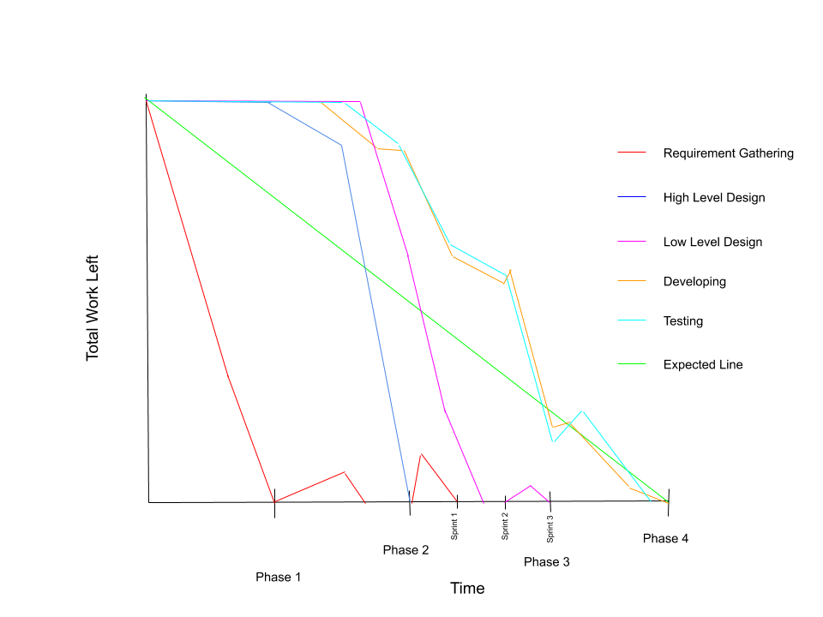
Burndown Chart
Average Velocity
Phase 1: 0.3 hours of work per day
Phase 2: 0.4 hours of work per day
Phase 3 Sprint 1:1.2 hours of work per day
Phase 3 Sprint 2: 0.3 hours of work per day
Phase 3 Sprint 3: 2.7 hours of work per day
Phase 4: 1 hour of work per day

Slide 5
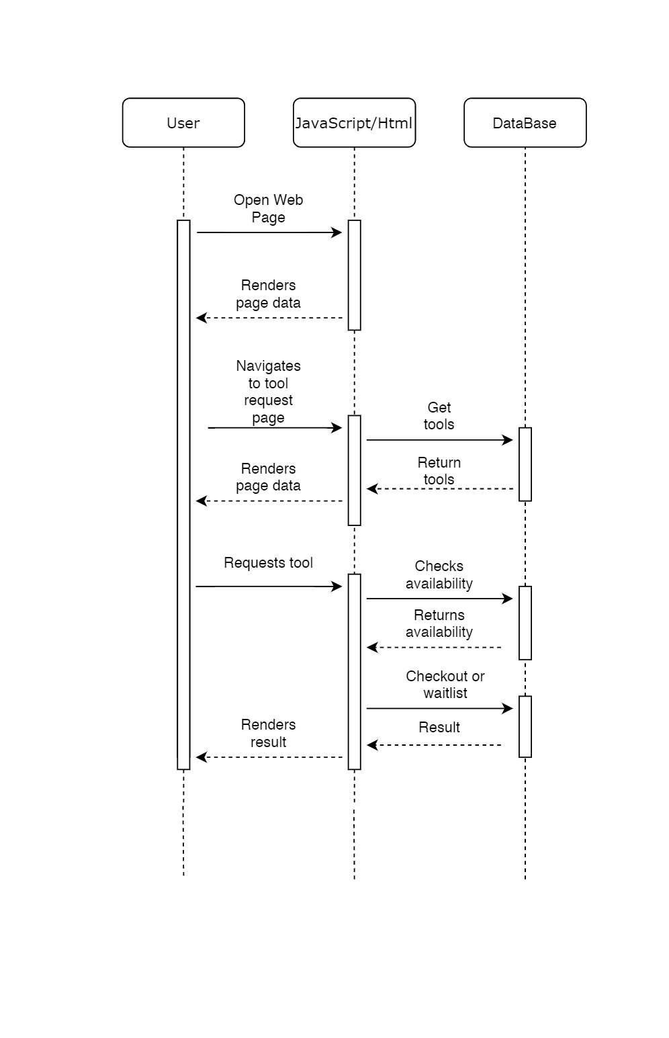
Reserving and Checking Out Tools Requirement
The user must be able to reserve and checkout tools.
(See docs folder in Github)
We wanted the user to select tools to checkout, and then navigate to a shopping cart to confirm or remove any selected tools. After a tool is checked out, it is added to the users list of tools and added to the ledger so employees can see tools to be picked up. We wanted to make sure a user is signed in first so we could confirm that they are old enough and active before checking out any tools.

Slide 6
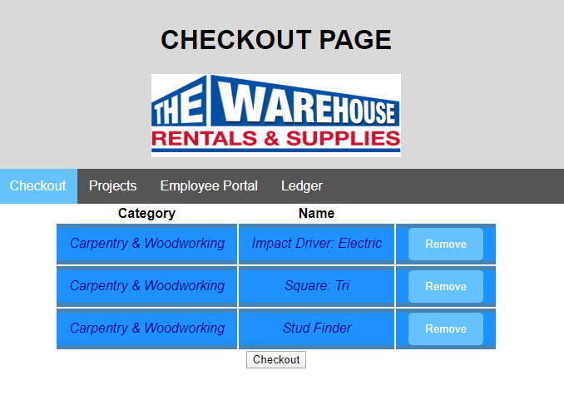
Reserving and Checking Out Tools Implementation
Story(Points) - Assignee
Don't allow checkout tools if there are no tools on-hand(0.5) - Christian
Add objects to customer(2) - Christian
No checkout until sign in(1) - Christian
Only allow users to checkout a tool if they have been signed in(1)--Christian/Kosta
Set up checkout page(2) - Christian
Checkout page backend(5) - Christian
Add button to tools(1) - Christian
Format tools.html to look good with the imported tools(0.5) - Johnathan
As a user I want a modal that shows the submission is accepted(0.5) - Christian

Slide 7
Reserving and Checking Out Tools Testing
When it came to testing, the database was heavily used. Started with making sure reserved tools are assigned to the correct user with the correct ID. Then making sure the tools populated in the checkout screen are the correct tools. We made sure, upon clicking checkout, tools are assigned to the user correctly. Finally we made sure that the values for on-hand and checked out of the tool are updated correctly. These are the different tests that we ran in order to make sure that reserving and checking out tools is working as we intended it to.

Slide 8
Check Inventory Requirement
The customer must be able to find tools to check out, and Employees must be able see inventory levels.
These tools should be easy to look through and find specific tools. It should be easy to filter the tools based on type, and to sort the tools based on metrics like number in stock.

Slide 9
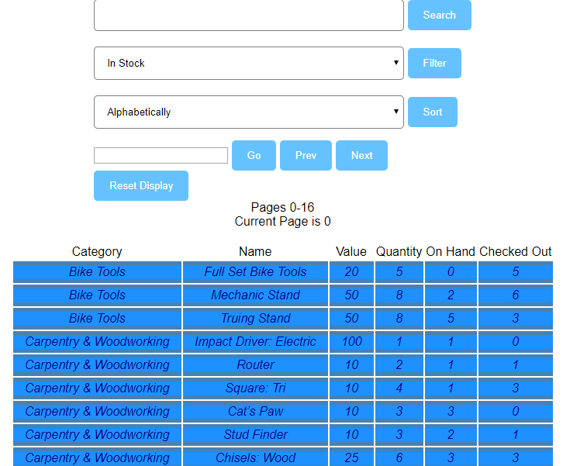
Check Inventory Implementation
Story(Points) - Assignee
Build Tools Page(1) - Johnathan and Christian
Populates Tools page with database of tools(1) - Christian
Sort Tools(2) - Johnathan
Filter Tools(1) - Johnathan
Search for Tools(1) - Johnathan
Multiple Pages of Tools (2) - Johnathan

Slide 10
Check Inventory Testing
Testing the tools page was at first about making sure that the Sort, FIlter, Search, and Page Change functions worked properly. This was done using javascripts console.log function to print out the states of the tool list to ensure everything was being affected properly, as well as by observing the correct result being produced by the functions on screen.

Slide 11
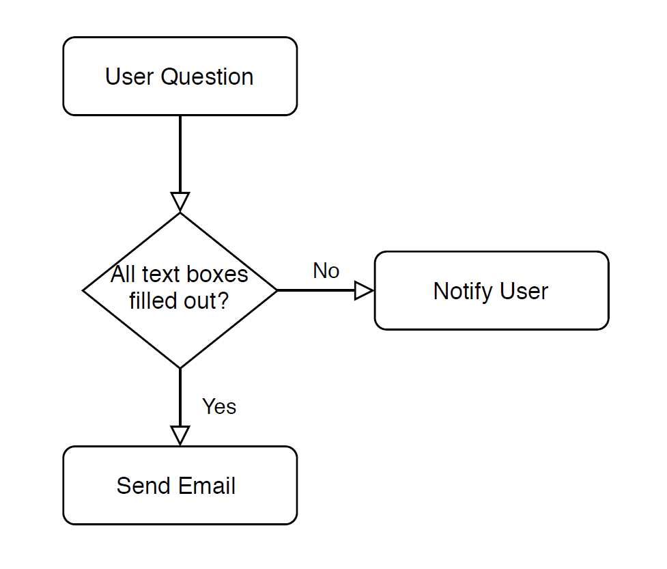
Contact Us Form Requirement
The customer should be to send us an email with questions/concerns. They can enter their name and email so we can get back to them asap.
We wanted to protect employee emails from spam by creating a contact us form that allows users to type their messages without ever accessing employee emails directly.
Add a google maps window at the bottom of the page that defaults to the store location (USU campus)

Slide 12
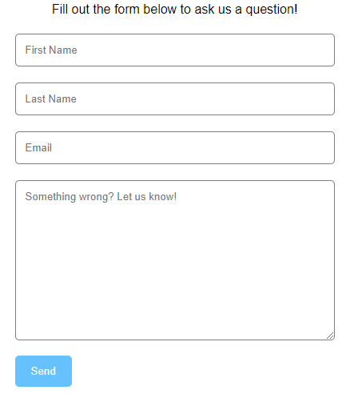
Contact Us Form Implementation
Story(Points) - Assignee
Gather important information about the user before allowing them to send a form. (1) - Kosta
Their email is included in the message in order to reply. (.5) - Kosta/Christian
All of the text boxes must be filled out in order to submit a form. (.5) - Kosta
Emails sent to a group email via Mailtrap.io, all employees have access to this email. (3)- Kosta/Christian
Google maps included at the bottom with Warehouse address. (2) - Brody

Slide 13
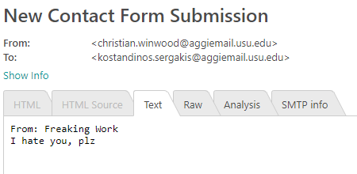
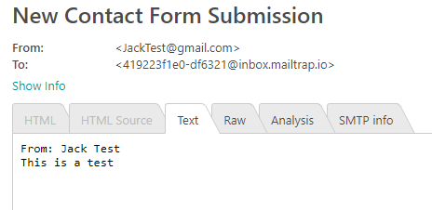
Contact Us Form Testing
When we started testing we needed to make sure a few fundamental things were happening. First, the emails had to be sent. Then, we had to gather the user’s name and email to display in the message. We tested using different email services to make sure emails were still being sent.

Slide 14
Questions?
Google Maps Tutorial. (n.d.). Retrieved from https://www.w3schools.com/graphics/google_maps_intro.asp
Java, Spring and Web Development tutorials. (n.d.). Retrieved from https://www.baeldung.com/
JavaScript Tutorial (n.d.). Retrieved from https://www.w3schools.com/js/default.asp
HTML Tutorial. (n.d.). Retrieved from https://www.w3schools.com/html/default.asp
JavaScript Arrays. (n.d.). Retrieved from https://www.w3schools.com/js/js_arrays.asp

